Slide 1
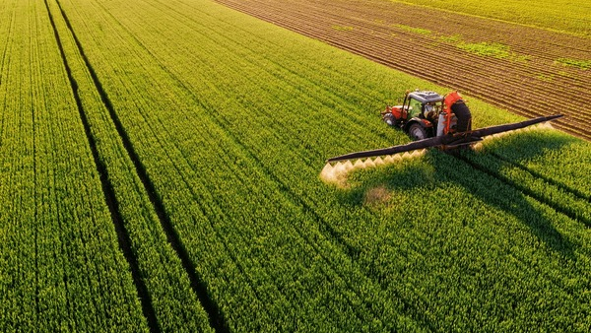
Agri Market
An Integrated Agriculture Web Platform
Project Team:
K. Swapna Kumari– 192210118
A. Sriveda – 192210530
Faculty
L. Reetha
SIMATS Engineering

Slide 2
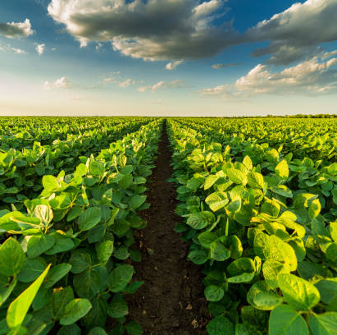
Abstract
•Agri Market is a digital solution designed to streamline agriculture by connecting farmers, customers, laborers, and administrators.
•The platform offers a marketplace for farm produce, access to agricultural inputs, job listings, and information resources.
•Agri market aims to create a sustainable agricultural ecosystem by improving market access, transparency, and accessibility.

Slide 3
MOTIVATION
Field visit to Agriculture Lands highlighted key challenges:
Farmers struggling with limited market access and resources.
Laborers face difficulties finding steady employment.
Agri Market addresses these issues by creating a unified digital platform for all stakeholders.
Customers lack access to fresh produce locally.

Slide 4
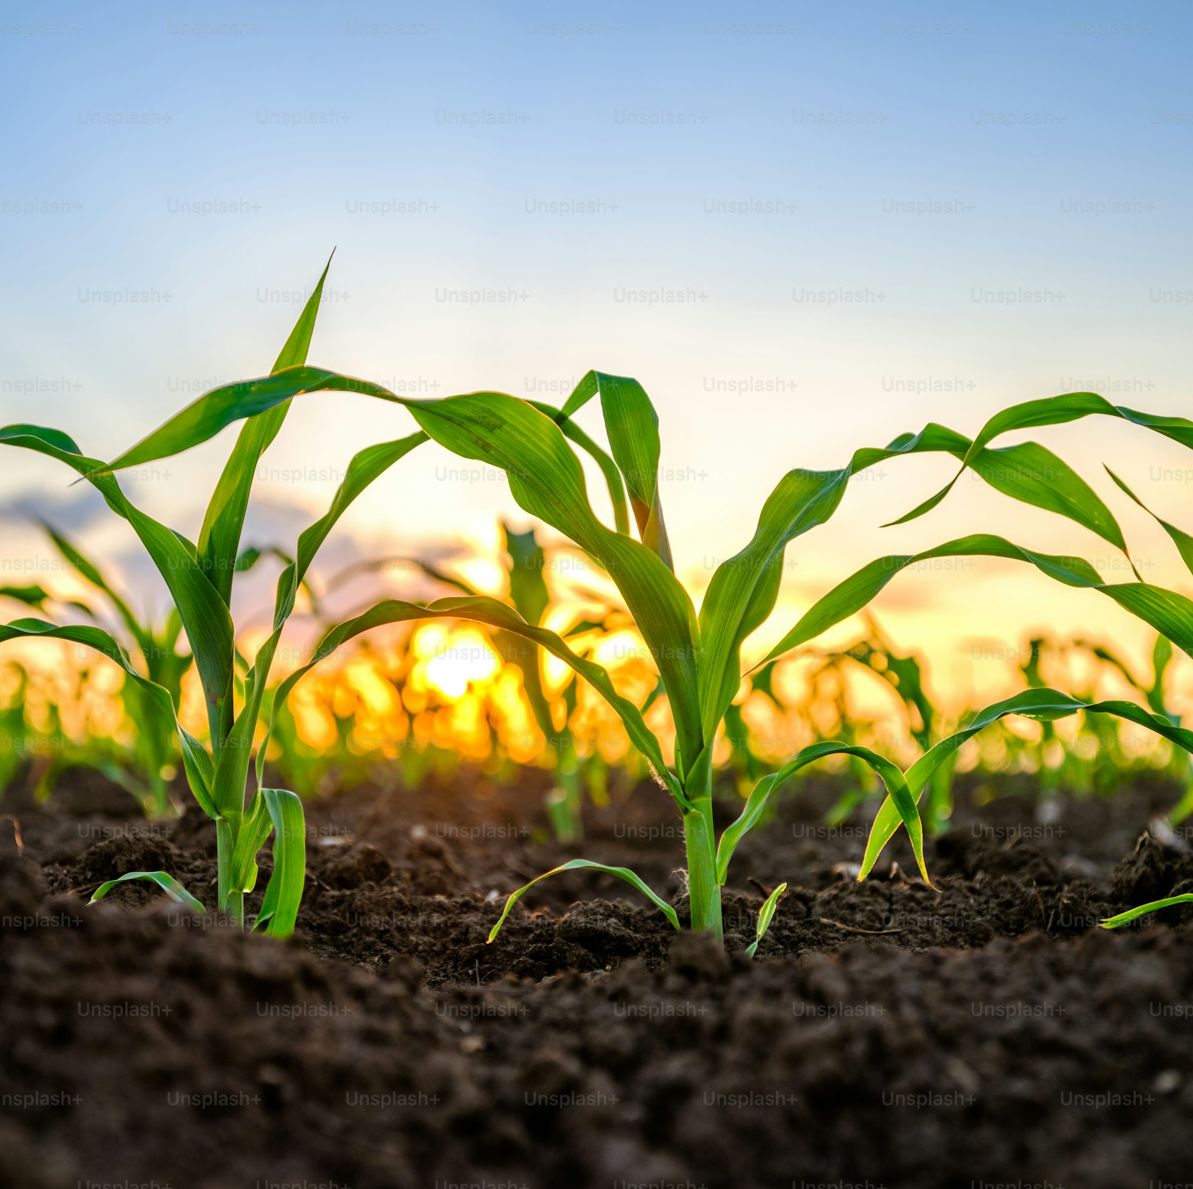
Problem Statement
•Agriculture faces a lack of centralized, efficient systems for market access and resource sharing.
•Farmers struggle with market reach and resource procurement.
•Customers find it challenging to source fresh produce easily.
•Laborers lack consistent employment opportunities.
•Agri Market provides a comprehensive solution to connect and support each stakeholder group.

Slide 5
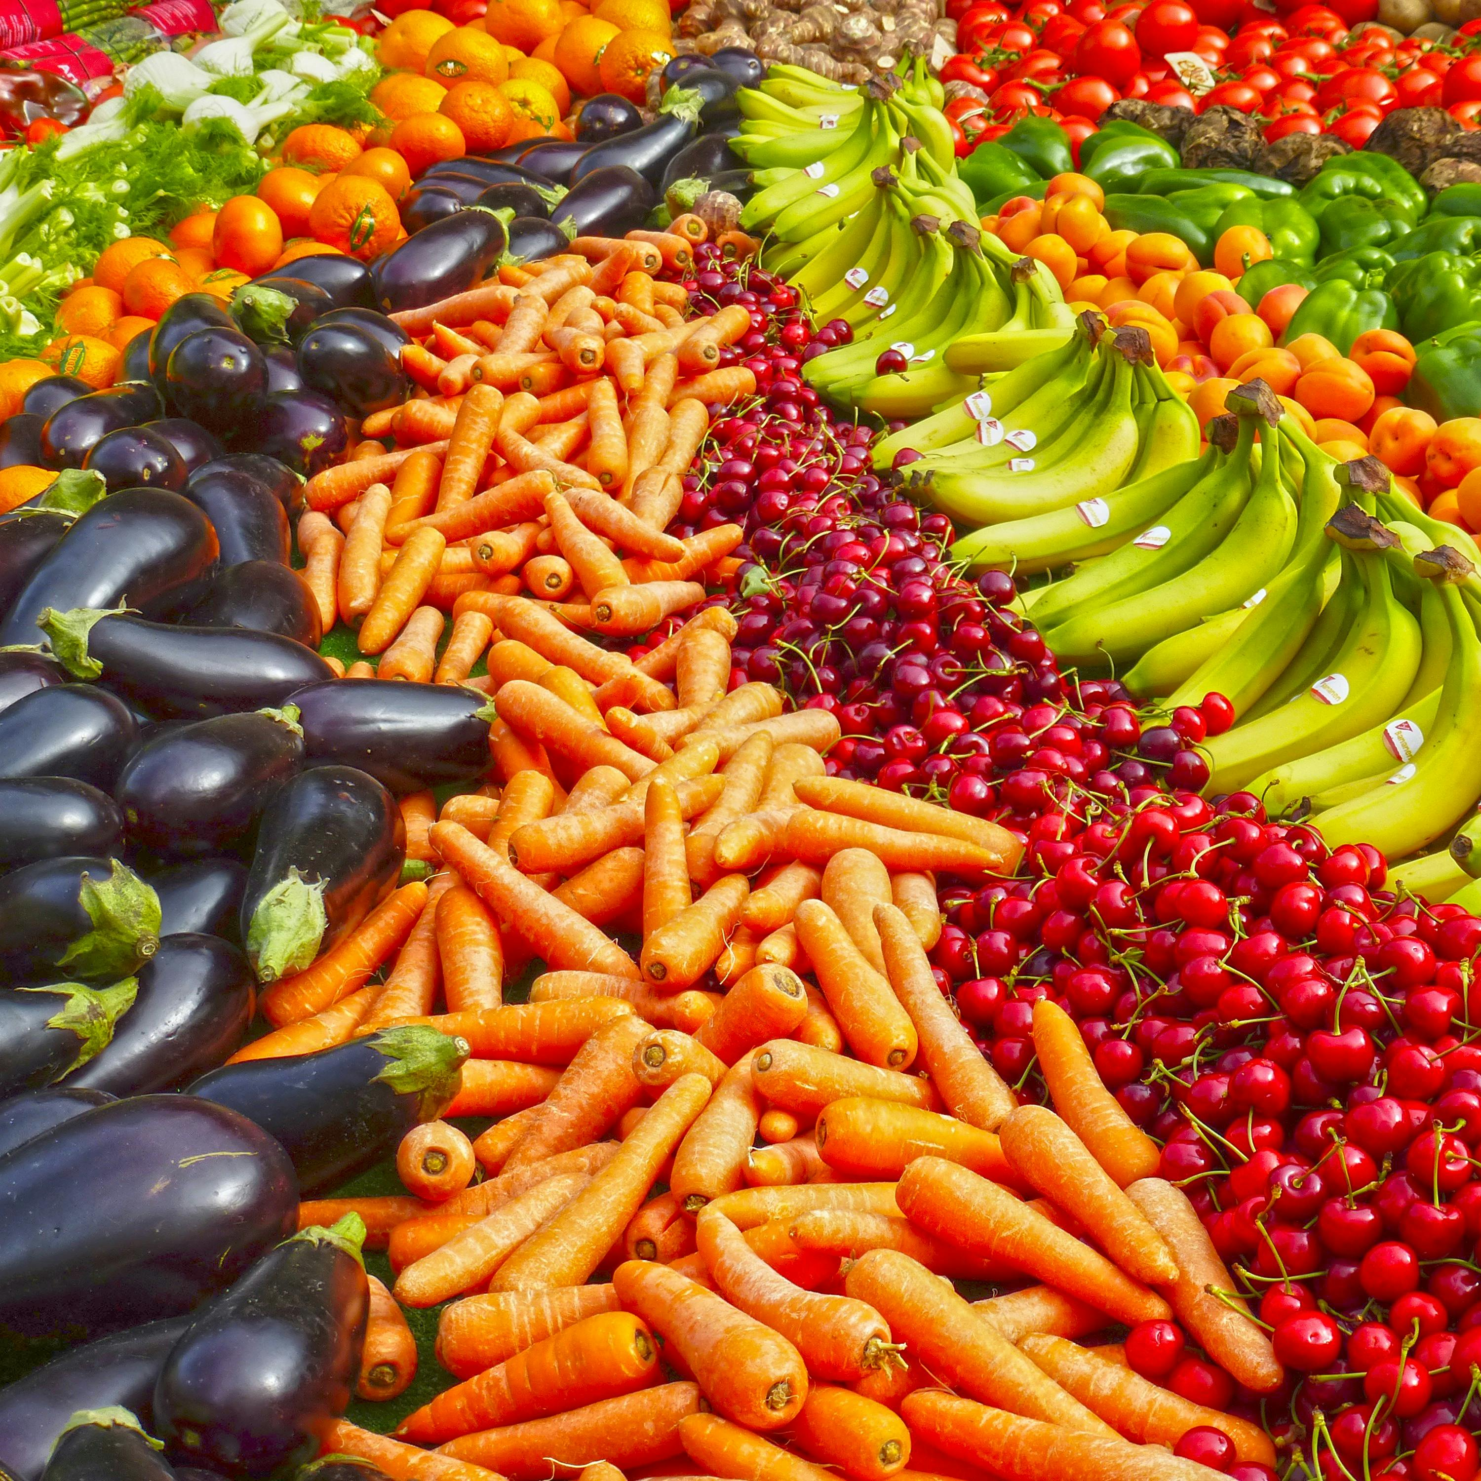
Objectives
Agri Market aims to:
• Provide farmers a marketplace to sell produce and access resources.
• Enable customers to directly purchase farm-fresh produce.
• Offer job listings for laborers seeking agricultural employment.
• Support administrators in managing listings and platform activities.

Slide 6
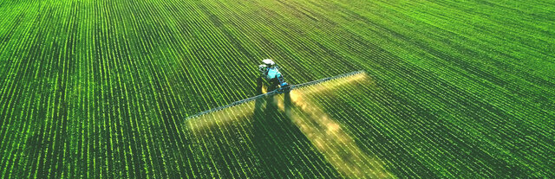
Domain - Agriculture
Agriculture is critical for rural economies, food security, and sustainable development.
Challenges in rural agriculture include limited market access, resource shortages, and technological barriers.
Agri Market leverages digital solutions to address these challenges, supporting sustainable agricultural practices and economic resilience.

Slide 7
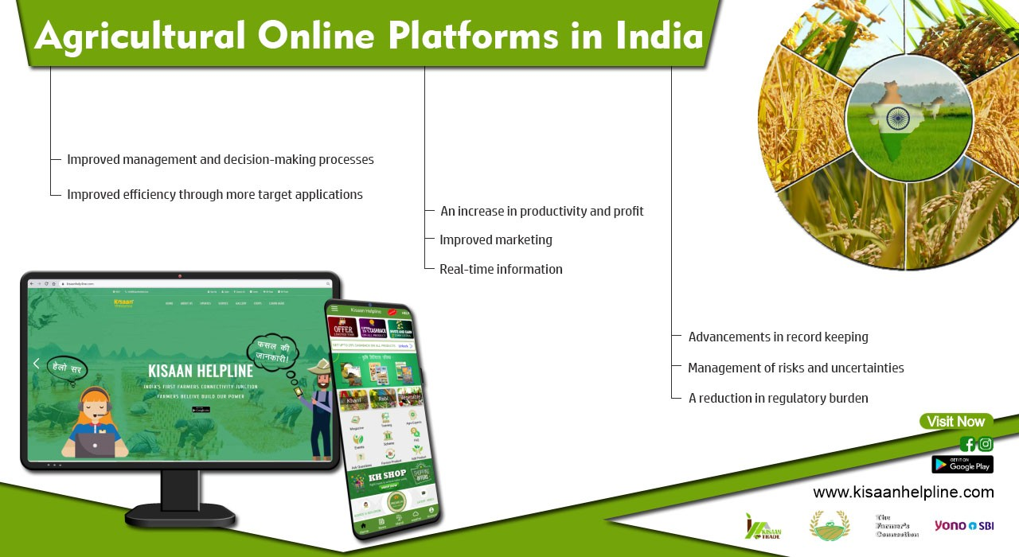
Existing Methods & Solutions
Key Points:
Traditional Market System: Farmers sell produce locally, often through intermediaries.
Limitations: Reduced profit margins, limited reach.
Digital Marketplaces (e.g., eNAM): Some platforms connect farmers to markets.
Limitations: Limited features; lacks job listings and resource procurement.
Job Boards and Local Hiring: Laborers depend on informal networks or seasonal work.
Limitations: Inconsistent availability, lack of structure.

Slide 8

Proposed Solution
Agri Market provides a digital hub to connect all agricultural stakeholders.
Farmers can sell produce and access resources.
Customers can purchase farm-fresh products directly.
Laborers find job opportunities easily.
Administrators manage platform integrity and user experience.

Slide 9
Solution Details – Farmer's
Marketplace for selling produce.
Access to essential tools, fertilizers, and pesticides.
Decision-making support with reviews and recommendations.

Slide 10
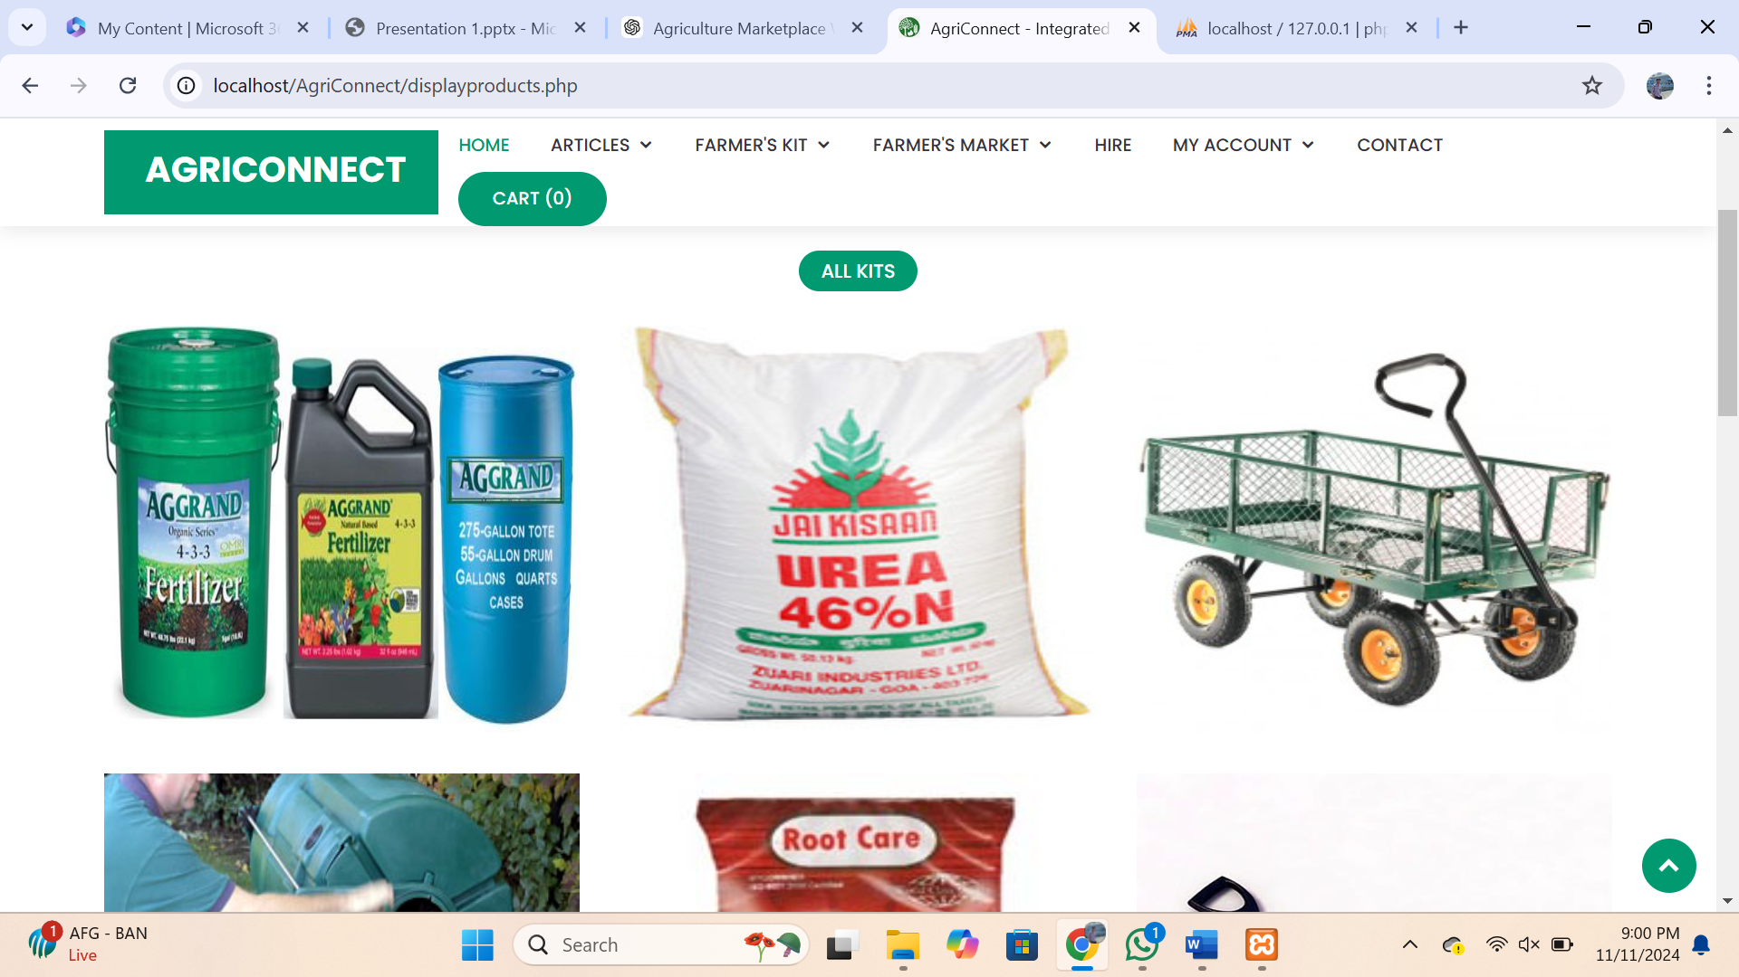

Slide 11
Solution Details – Customer's
Access to fresh produce directly from farmers.
Transparent, reliable purchasing with product descriptions and reviews.
Encourages support for local agriculture.

Slide 12
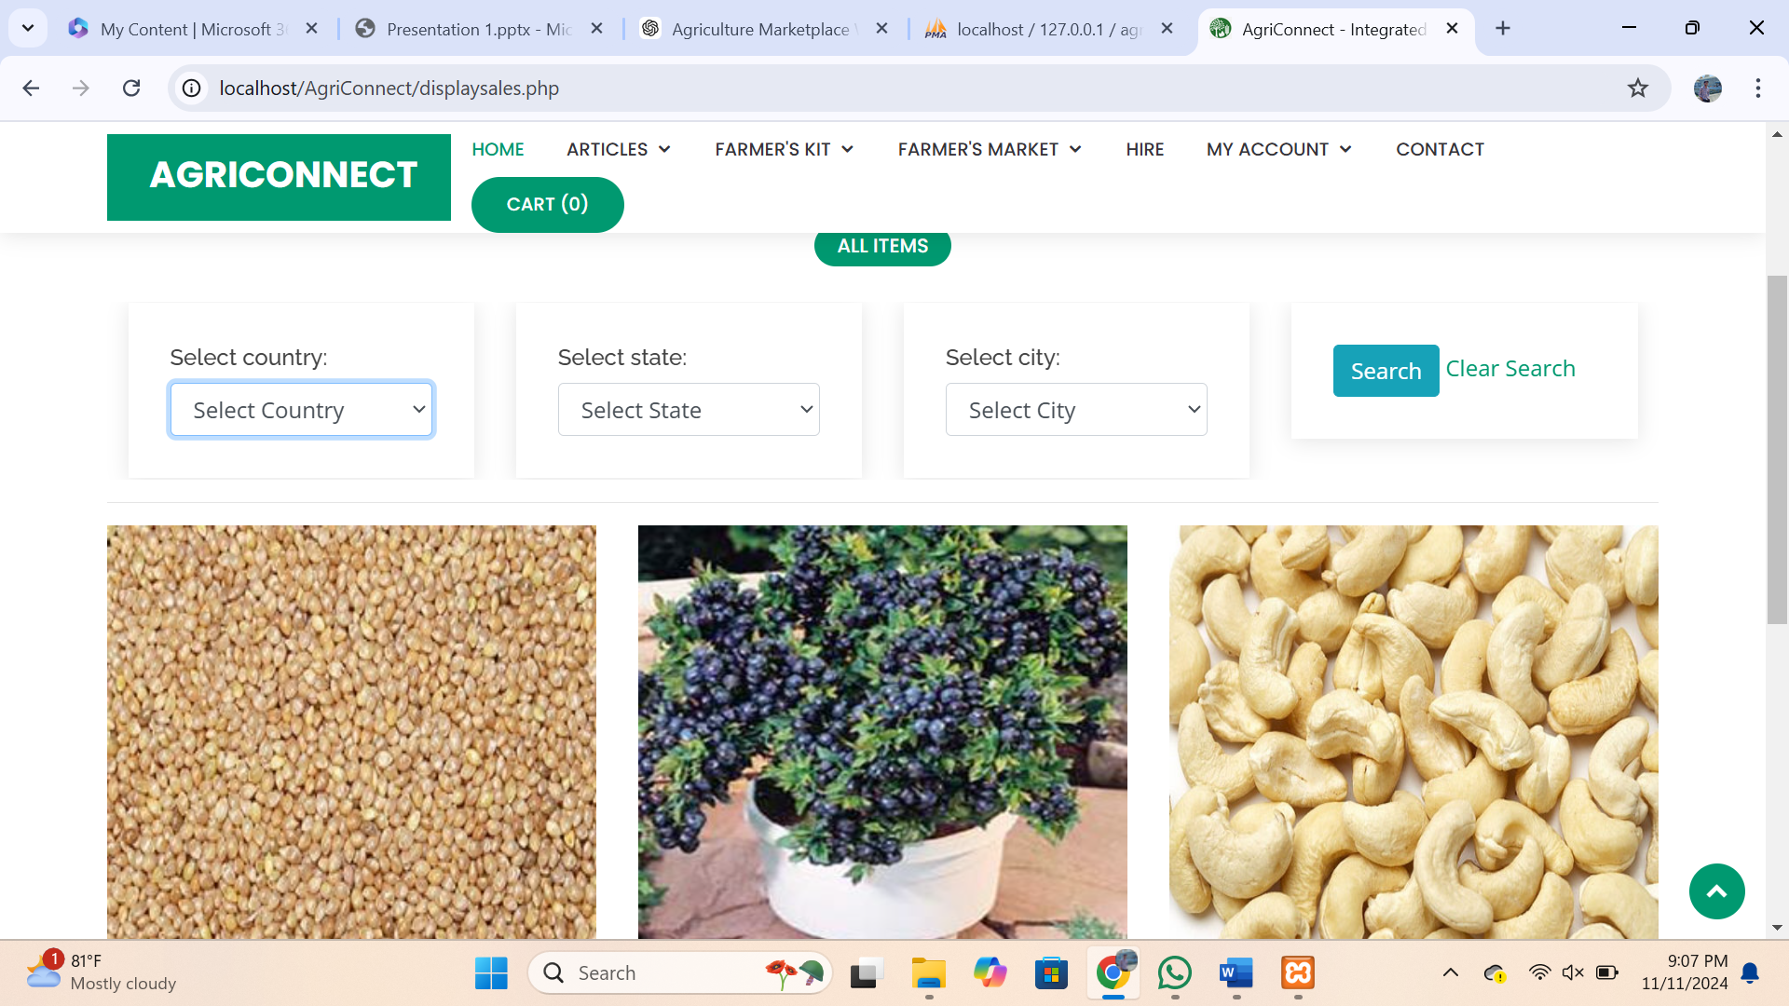

Slide 13
Job Opportunities for Labourers
Employment platform for agricultural workers.
Job matching and notifications for labor availability.
Reduces seasonal employment gaps.

Slide 14

Solution Details - Administrator
Role in managing product listings and user accounts.
Content moderation for quality control.
Ensuring platform compliance and data accuracy.

Slide 15

Knowledge Hub and Resources
Provides articles, blogs, and news on agricultural topics.
Improves awareness and skill levels of farmers and laborers.
Fosters community engagement.

Slide 16
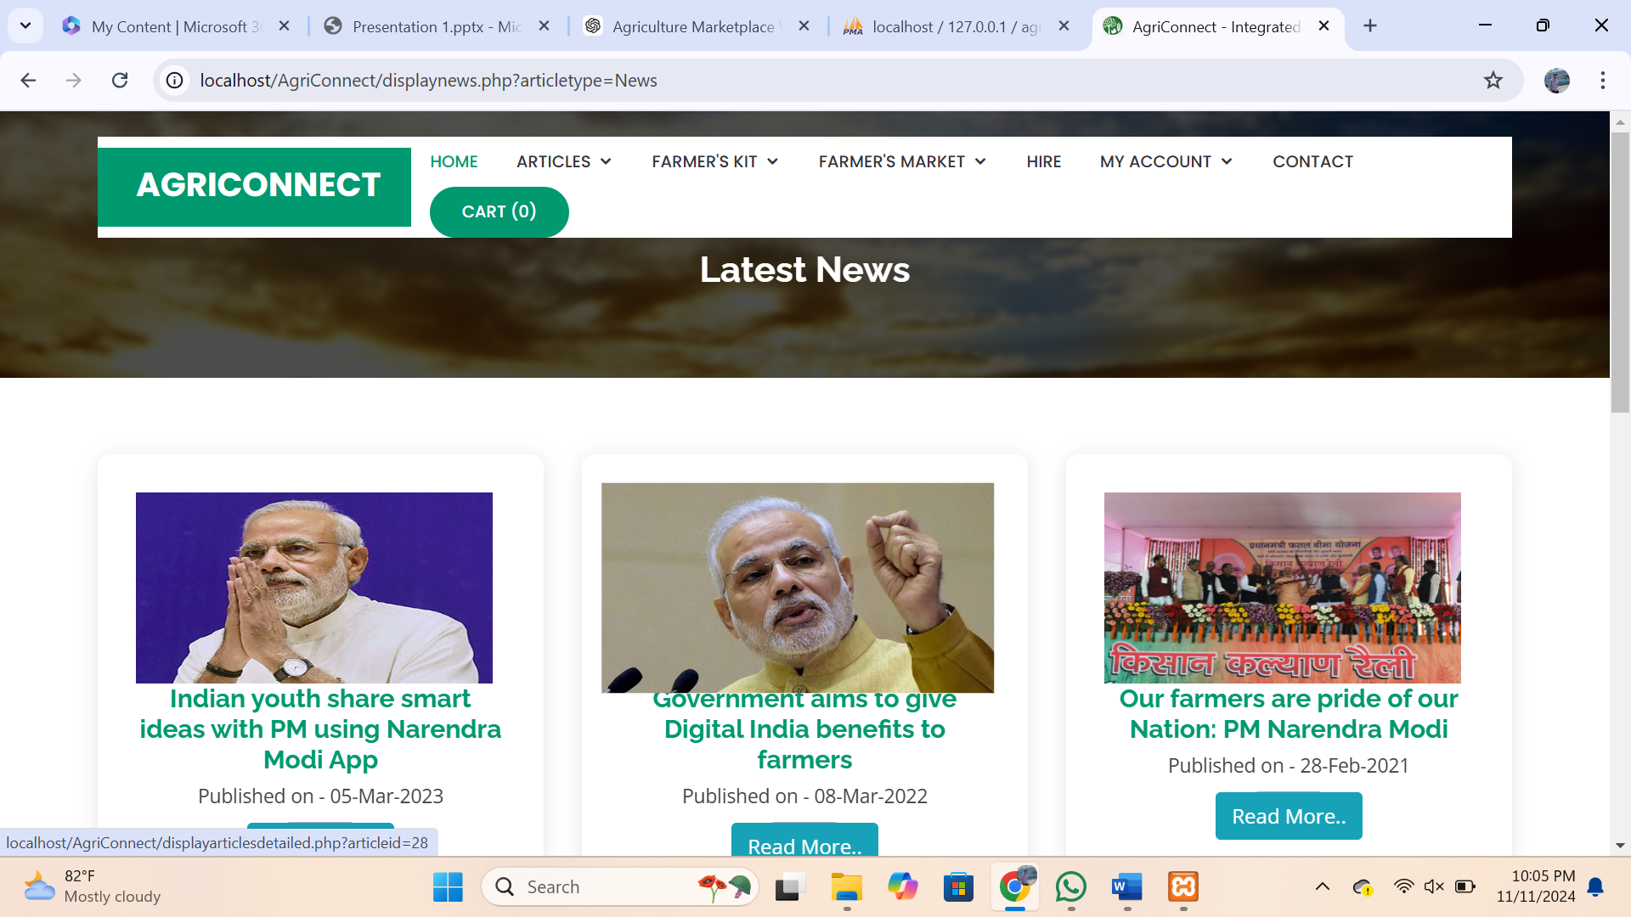

Slide 17
Benefits of Agri Market
Economic growth and stability for rural communities.
Improved food quality and safety with direct farm-to-table approach.
Reduced environmental impact and sustainable practices.
Community building and knowledge-sharing opportunities.

Slide 18

Technology Stack
Frontend: HTML, CSS, JavaScript for a responsive interface.
Server-side: PHP for managing user interactions and transactions.
Database: MySQL for secure data storage.
Development Environment: XAMPP for local hosting and testing.

Slide 19
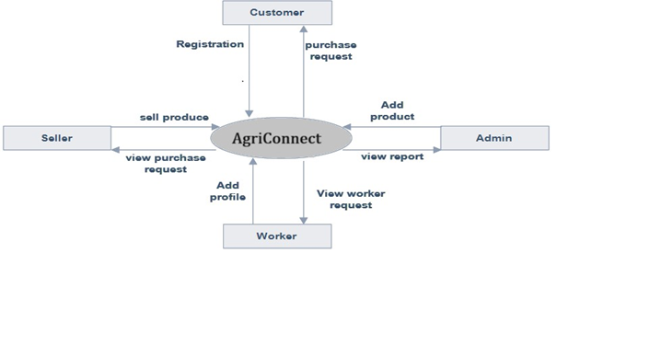
Flow Chart/Block Diagram

Slide 20

Future Work
Mobile app development for broader accessibility.
AI-based recommendations for crop selection and resource purchases.
Payment gateway integration for secure transactions.
Multilingual support for wider accessibility.

Slide 21
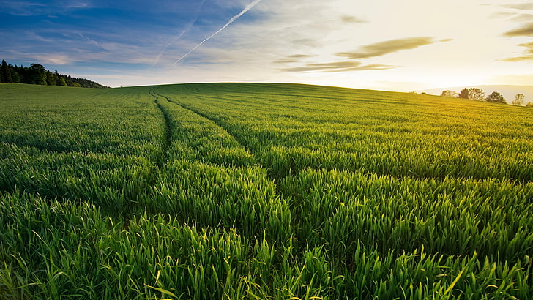
Conclusion
Agri Market as a transformative platform for the agricultural sector.
Bridging gaps in accessibility, resources, and market reach.
Contributes to sustainability, economic growth, and improved livelihoods for rural communities.

Slide 22


Slide 23


